Slide 1
Section 1.1 The Coordinate Plane
Lecture 1
Cartesian (Rectangular) Coordinate System

Slide 2
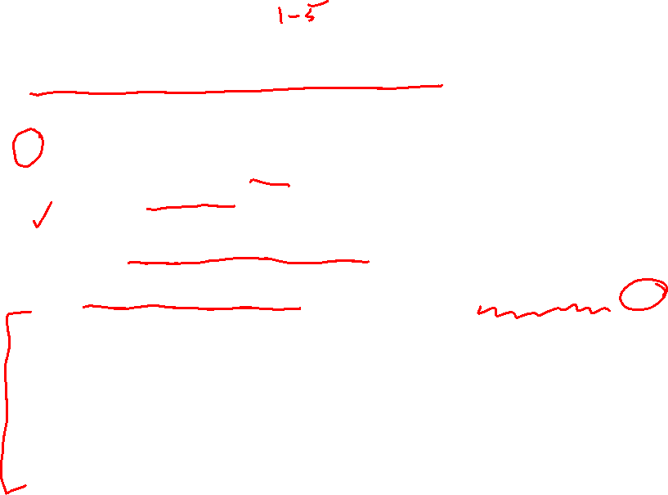
Section 1.1 Homework Submission to Canvas
Preview of section
Skim the section in text and write a short paragraph summary.
Give a bulleted list of all important definitions, theorems, and formulas without details.
Notes on video lectures
Take notes on everything written on slides including all details, worked examples, on-own activities, as well as your own thoughts and questions.
Try on-own activities first, then write down provided solution next to it for comparison.
Worked examples from the text
Write down the problem and attempt without looking at the solution.
Use the solution to write the best explanation you can.
Solutions to textbook exercises
Model approaches and explanations given in the video lectures and textbook examples.
Final reflection of section
List the key takeaways to remember as a bulleted list.

Slide 3
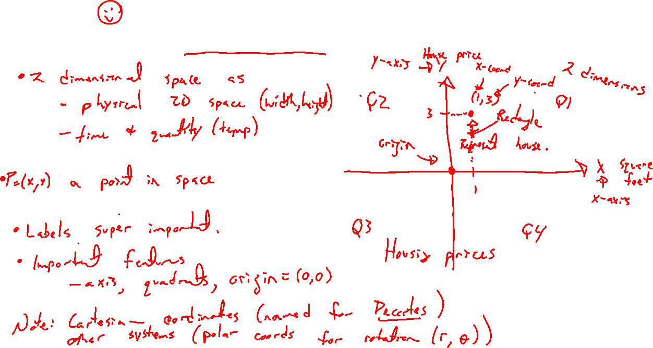
Cartesian (Rectangular) Coordinate Plane
Notes:
Draw coordinate plane
X, y axis
(x,y) = point, over and up, not same as (y,x)
Units and labels (housing example)
Example point. What does it represent?
Origin, quadrants
Note, other coordinate systems (polar coords for rotation)

Slide 4
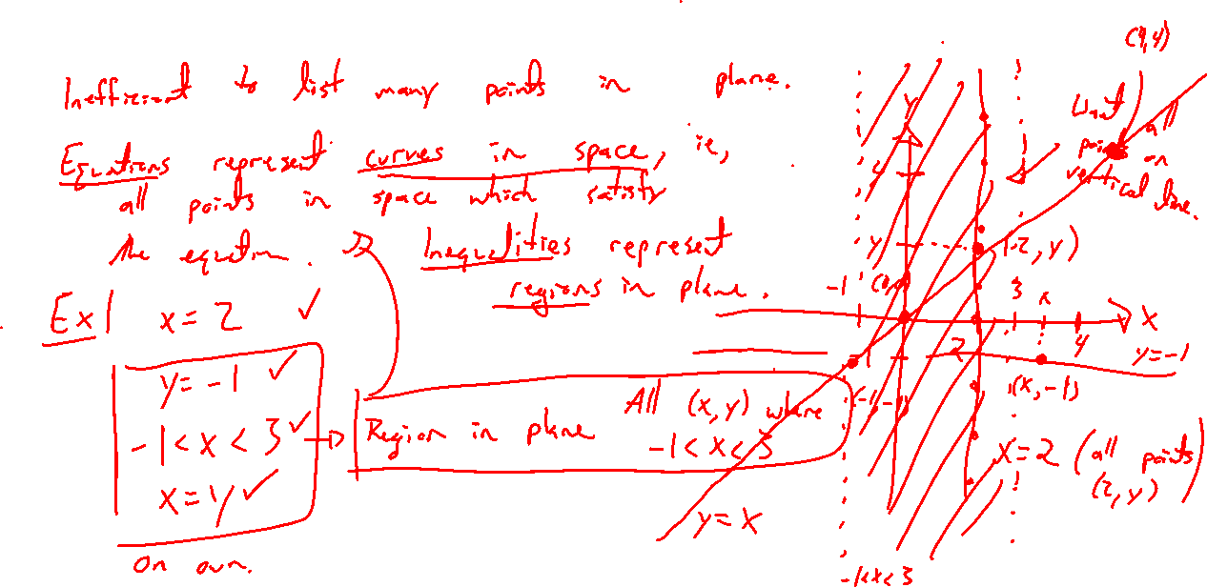
Curves and Regions in the Cartesian Plane
Notes:
Efficient to define many points at once
Ex: x=4, y=-2, -1 <x <=3, y>1 and x<=0, x=y

Slide 5
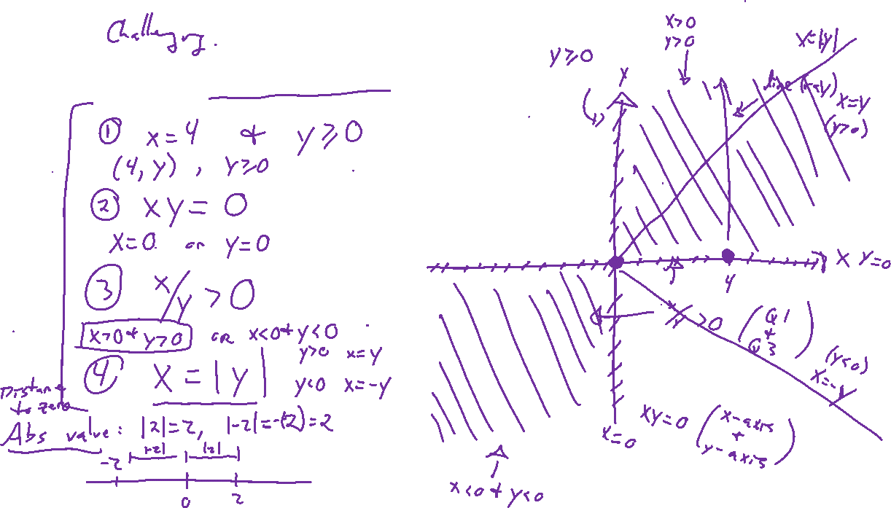
Example: Try on Own
Notes:
X=4 and y>=0
Y=-2 and –1<=x < 0
Xy=0
Xy>0
Y=|x|
X=|y|

